Slide 1
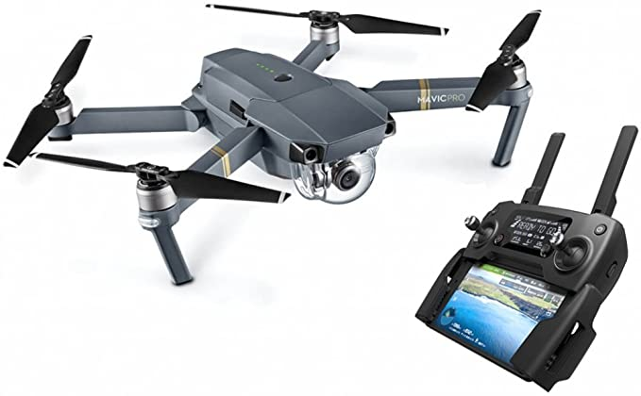
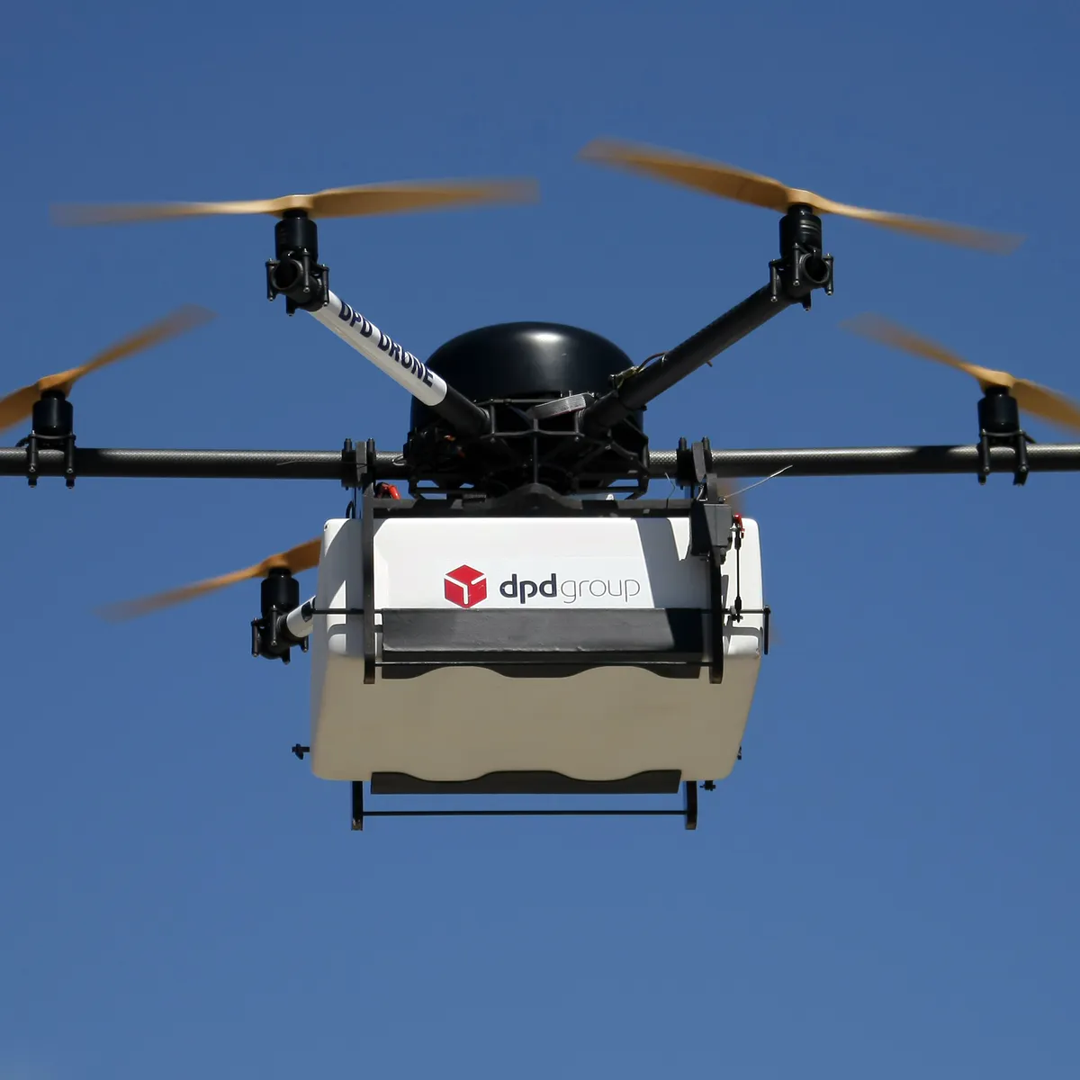
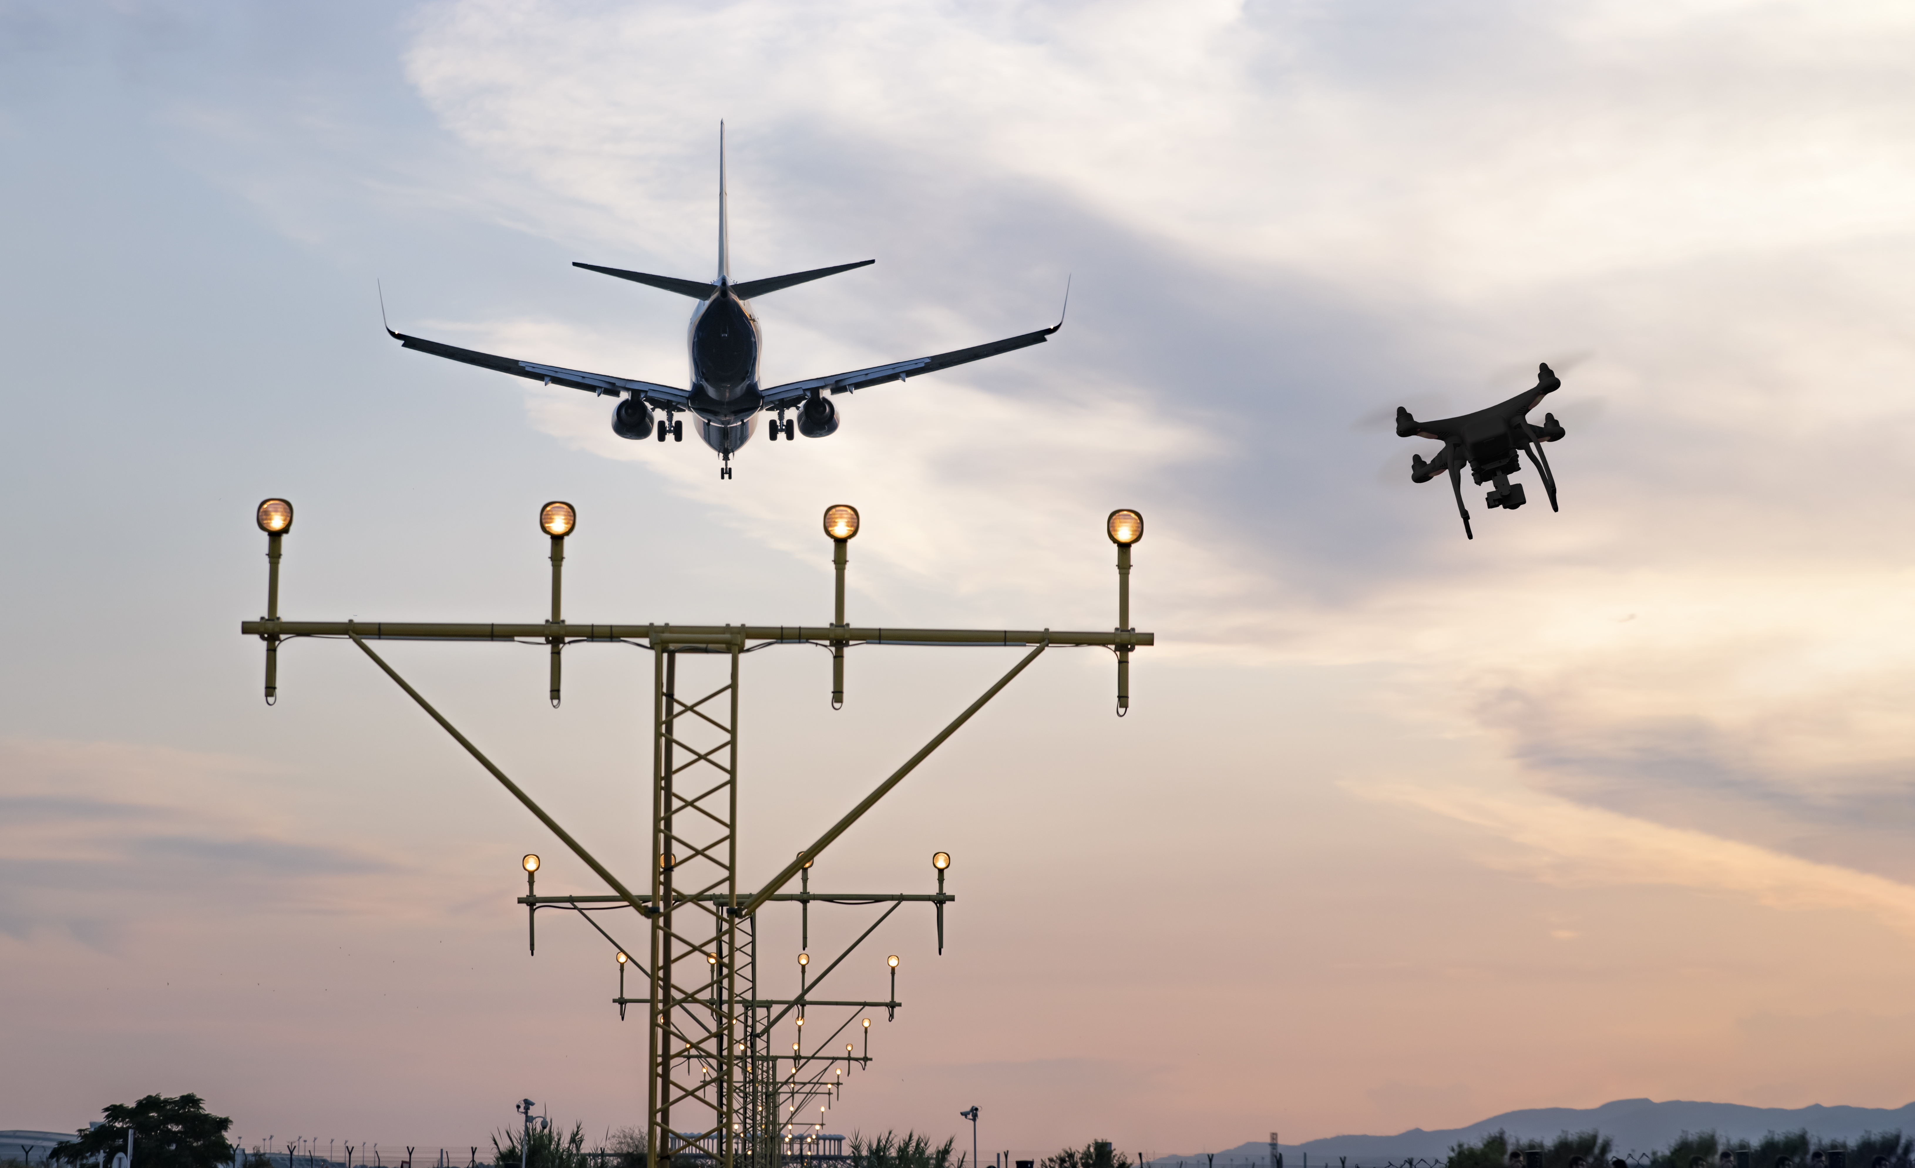
Drone detection
Which kind of drones?
Low cost and ease of use
Benefit in agriculture engineering, package delivery, security
High diffusion among people
Growth of incidents due to unauthorized drones:
Airport (Gatwick 2018), ISIS attacks with DJI Phantom, Attempt to president Maduro
To better understand the goal:
1. Features of the subject to detect
2. Environment characteristic

Slide 2
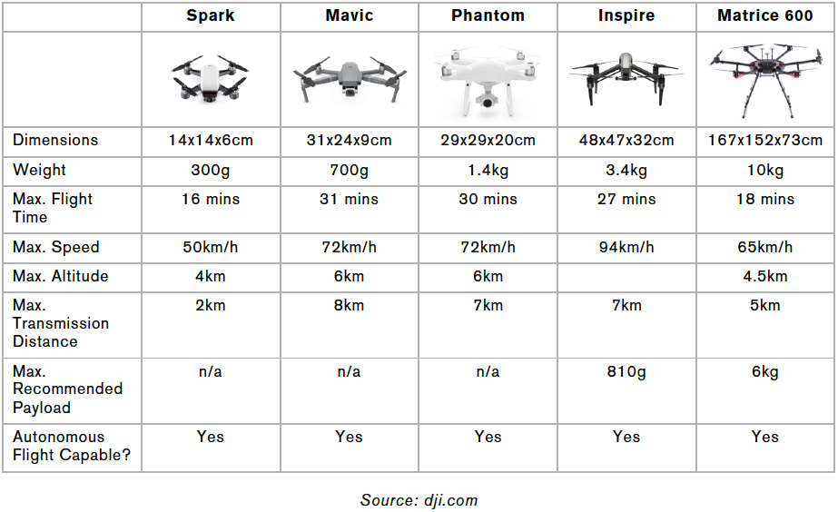

Features of the drones
New and young technology
Advanced and mature technology
Very small dimension, tens of cm
Velocity from 50 km/h to 140 km/h
Range of about 10 km from controller
Altitude of about 6 km
Tech difference with commercial drone defense

Slide 3


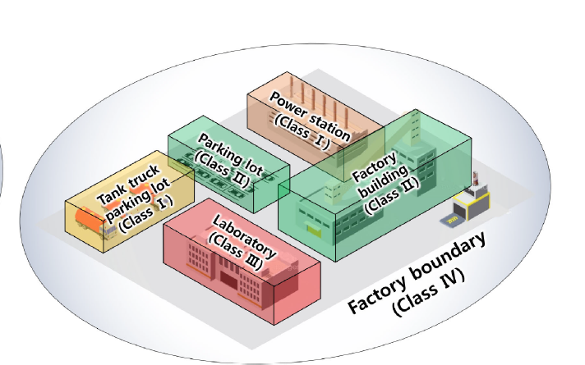
Environment
1. Wide and high risk area:
Complexity and expensive system of military level
2. Civil environment:
Low cost, and simple system
Airport, public institutions
Portable solutions
Crowded squares, public events
Fixed solutions
Buildings, power plants, prisons
We select this context

Slide 4
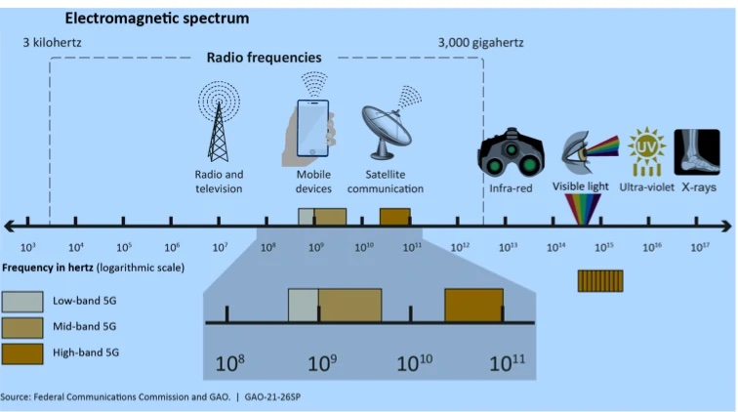
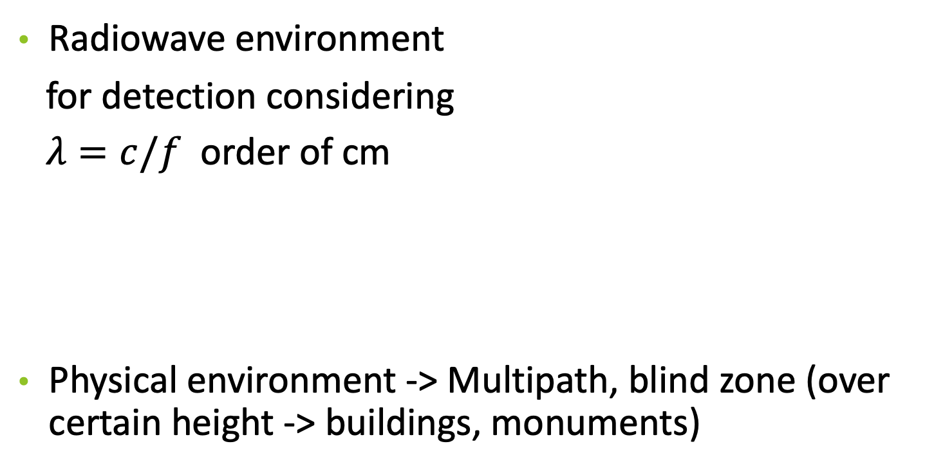
Environment
Radiowave environment
for detection considering
$λ=c/f$ order of cm
Physical environment -> Multipath, blind zone (over certain height -> buildings, monuments)

Slide 5
Detection solution
Range of hunderd of m
Privacy
Thermal Optic/IR cameras
Radio Frequency RF scanner
Radar FMCW radar
Sound Acoustic sensors
Autonomous flight
More complete solution
Noise env.
Very short range
→ Hybrid is the most complete system!
But also radar has its limitations: Identification (Birds vs Drone), Tx license,Interference
Rotating parts (Micro doppler)
Spectrum analysis

Slide 6
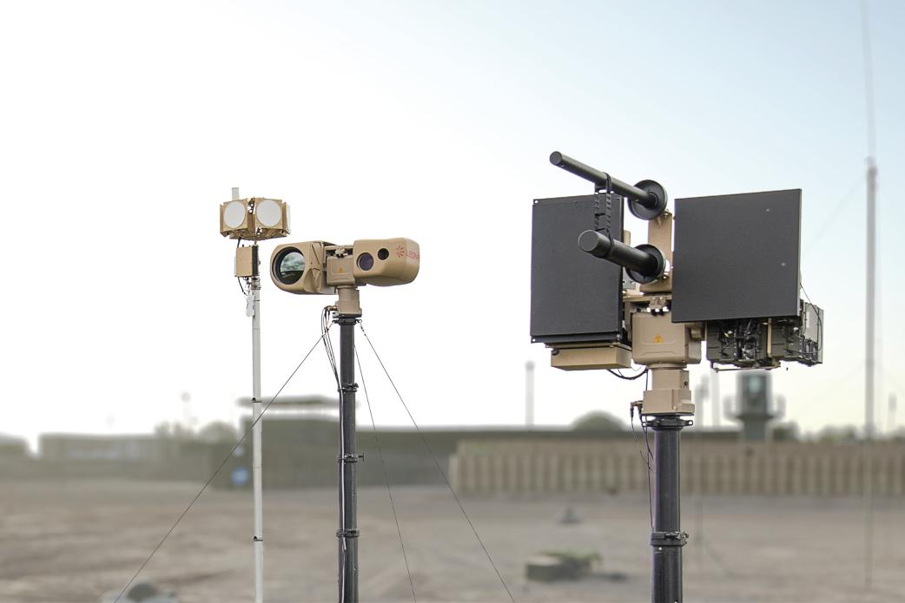
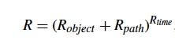
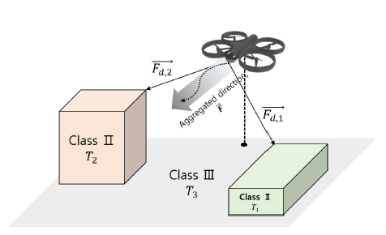
Complete system
Leonardo Falcon Shield
3
1
1 Detection + Pre-Identification
2 ID + Valutazione del livello della minaccia
3 Neutralization
Radar + EO camera
Jamming antennas
2
Rapid evolution of drones
-> Modular system
–> Upgradeable

Slide 7
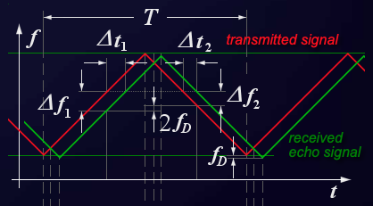
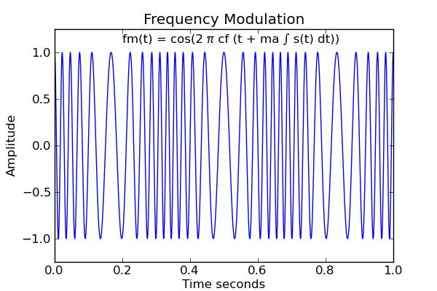
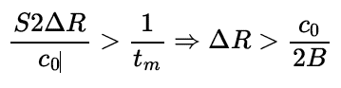
Focus on radar solution
Possible solution for this purpose --> FMCW Radar
We can measure both velocity and distance
Low peak power trasmitted and LPI
Better distance resolution

Slide 8
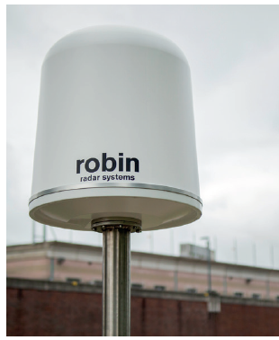
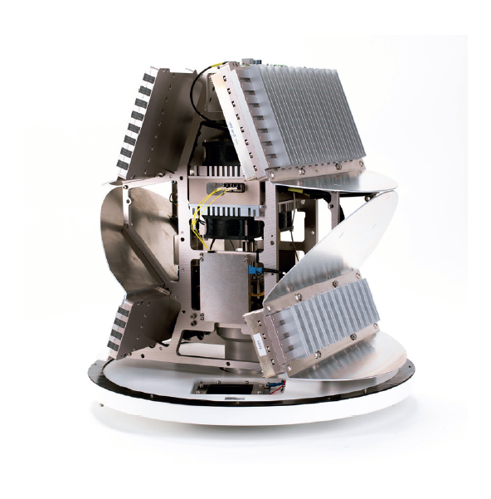
State of art
Robin Radar solution -> IRIS
FMCW Solid State 3D radar
X-Band (8900-9650 MHz)
Detection range 4 km
Classification range 1.4 km
Azimuth accuracy 0.6°
Range accuracy 0.6 m
Classification method Micro doppler
Power 2x12 W (continuos)
Smaller
easy to deploy
Cost

Slide 9
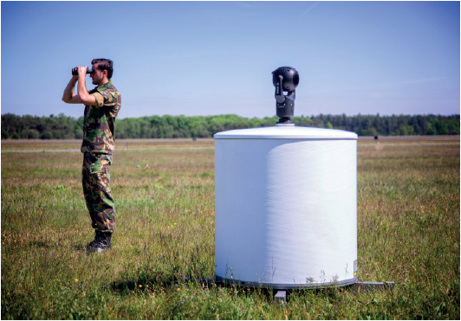
State of art
Robin Radar solution -> ELVIRA
FMCW Solid State 2D radar
X-Band (8700-9650 MHz)
Detection range 2.7 km
Classification range 1.1 km
Azimuth accuracy 1°
Range accuracy 0.6 m
Classification method Micro doppler
Power 4 W (Continuous)
Less small
2D
Less cost

Slide 10
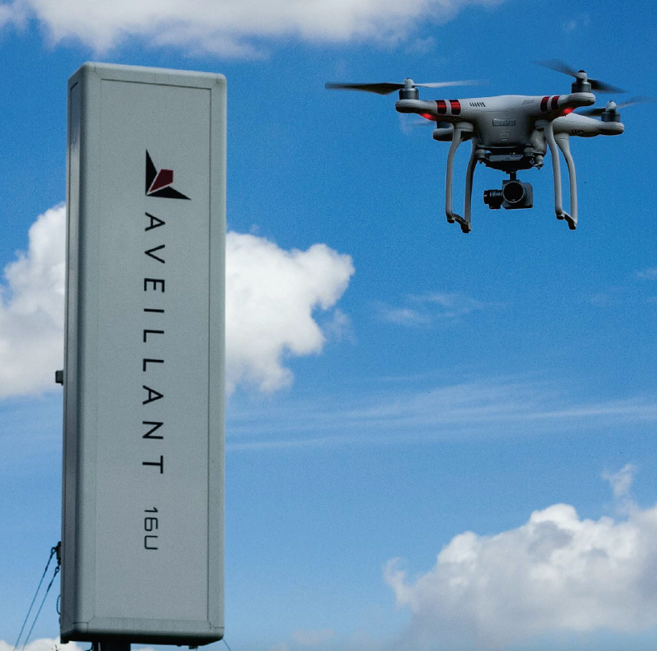
State of art
Aveillant solution -> Gamekeeper 16u
Holographic 3D radar
L-Band (1000-2000 MHz)
Detection range 7.5 km
Classification range 5 km
Peak power 2 kW
max altitude 900 m
Complexity
High cost

Slide 11
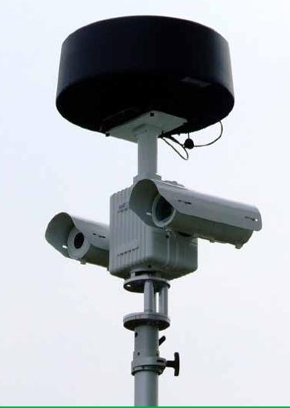
State of art
Kelvin Hughes solution-> Spexer 360
Solid state pulse radar
X band 9.22 - 9.38 GHz
Peak power 80 W
Micro UAV (0.03^2 RCS) 2.4 km
Range accuracy RMS 5 m
Azimuth accuracy RMS 0.8°
Pfa 10^-4
Range resolution 28 m
Low resolution
High power

Slide 12
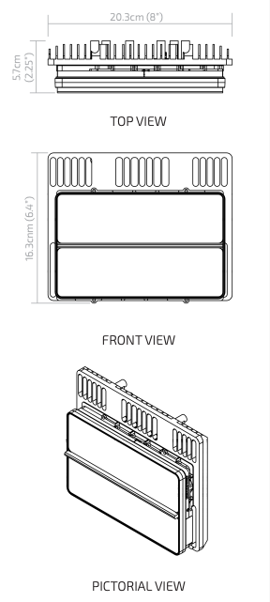
State of art
Droneshield-> RadarZero
Metamaterial-based radar
K band (24.45 - 24.65 GHz)
Detection small drone range 750 m
Power 3.4 W
Main Beam Width 80° x 90°
Azimuth accuracy 1°
Low cost
1 km range

Slide 13
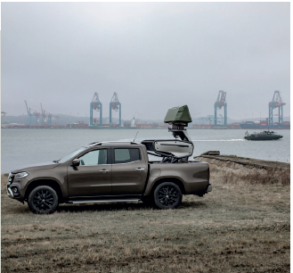
State of art
SAAB solution -> Giraffe 1X
Stacked beam 3D radar
X-Band
Detection range small UAV 4 km
Power 2 kW
Radar weight <300 kg
Not so portable
High power
High cost

Slide 14
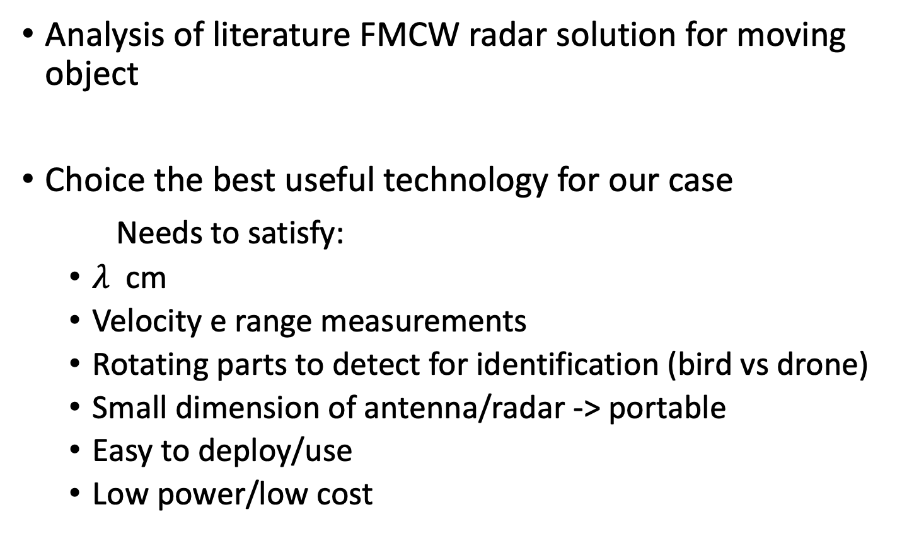
Next Step
Analysis of literature FMCW radar solution for moving object
Choice the best useful technology for our case
Needs to satisfy:
$λ$cm
Velocity e range measurements
Rotating parts to detect for identification (bird vs drone)
Small dimension of antenna/radar -> portable
Easy to deploy/use
Low power/low cost

Slide 15
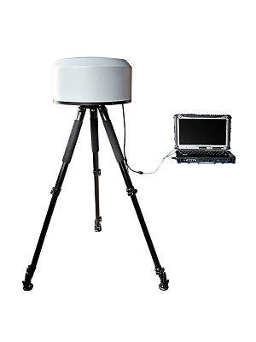
RF scanners triangulation technique

Slide 16
Vendor, Model | Combined techniques | Range
ELTA, Droneguard | Radar + RF scanner + Camera | 4.5 km
Aaronia, AARTOS DDS | Radar + Camera | 5 km
APS, Ctrl+sky | Radar + RF scanner + Camera + Acoustic | 3 km
Cerbari | RF scanner + camera | 3 km
Rodhe e Schwartz, Adronis | RF scanner | 3 km
Droneshield, Sentinel | Radar + RF scanner + Camera + Acoustic | 3.5 km

Slide 17
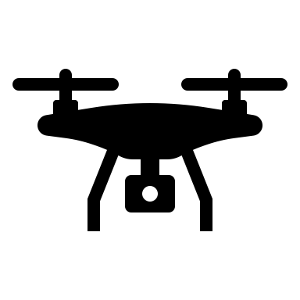



New attachment
Hijacking module

Slide 18
SPEC | IRIS | ELVIRA
Technology | FMCW | FMCW
Frequency | X-Band (8900-9650 MHz) | X-Band (8700-9650 MHz)
Power Output | 2 x 12 Watt | 4 Watt
Instrument Range | 5 km | 5 km
Detection Range | 4 km | 2.7 km
Classification Range | 2.2 km | 1.8 km
Main Beam Width | 6 ° x 60 ° | 10 ° x 10 °
Rotation | 30 rpm | 46 rpm
Classification Method | Micro-Doppler | Micro-Doppler
Range Accuracy | 0.6 m | 0.6 m
Azimuth Accuracy | 0.6 ° | 1 °

Slide 19
Radar detection pro | Radar detection cons
Long range detection | Low RCS’s drone
Drone’s autonomous flight | Distinction from birds
Constant tracking | Transmission frequency license
Independence of visual condition | Interference
High accuracy localization | Low speed

Slide 20
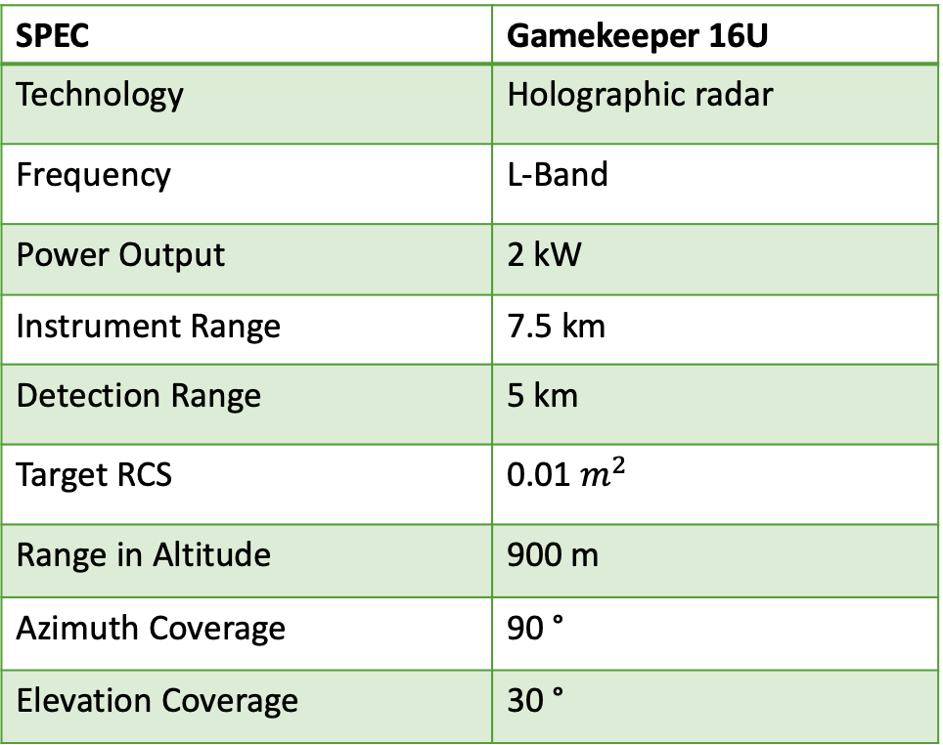
SPEC | Gamekeeper 16U
Technology | Holographic radar
Frequency | L-Band
Power Output | 2 kW
Instrument Range | 7.5 km
Detection Range | 5 km
Target RCS | 0.01 $m^{2}$
Range in Altitude | 900 m
Azimuth Coverage | 90 °
Elevation Coverage | 30 °

Slide 21
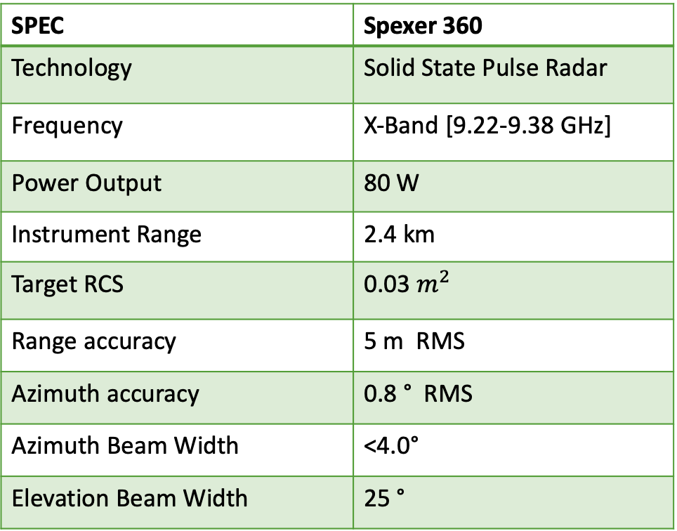
SPEC | Spexer 360
Technology | Solid State Pulse Radar
Frequency | X-Band [9.22-9.38 GHz]
Power Output | 80 W
Instrument Range | 2.4 km
Target RCS | 0.03 $m^{2}$
Range accuracy | 5 m RMS
Azimuth accuracy | 0.8 ° RMS
Azimuth Beam Width | <4.0°
Elevation Beam Width | 25 °

Slide 22
SPEC | Droneshield Radar Zero
Technology | -
Frequency | K band (24.45 - 24.65 GHz)
Power Output | 3.4 W
Instrument Range | 1 km
Target RCS | -
Range in Altitude | -
Azimuth Coverage | 80°
Elevation Coverage | 90°
Azimuth Accuracy | 1 °

Slide 23
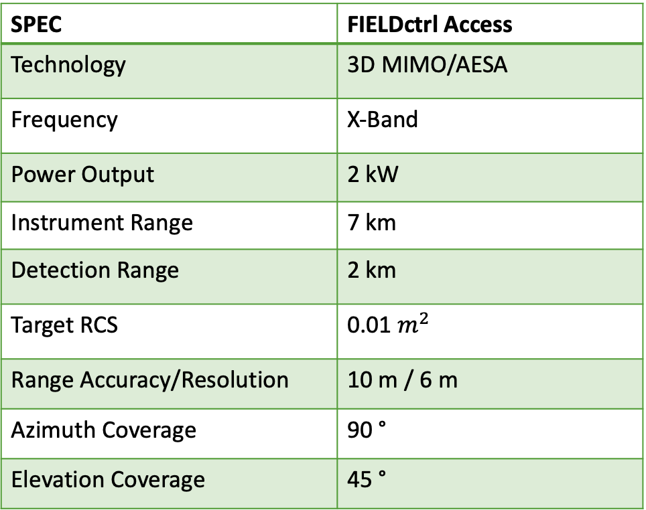
SPEC | FIELDctrl Access
Technology | 3D MIMO/AESA
Frequency | X-Band
Power Output | 2 kW
Instrument Range | 7 km
Detection Range | 2 km
Target RCS | 0.01 $m^{2}$
Range Accuracy/Resolution | 10 m / 6 m
Azimuth Coverage | 90 °
Elevation Coverage | 45 °

Slide 24
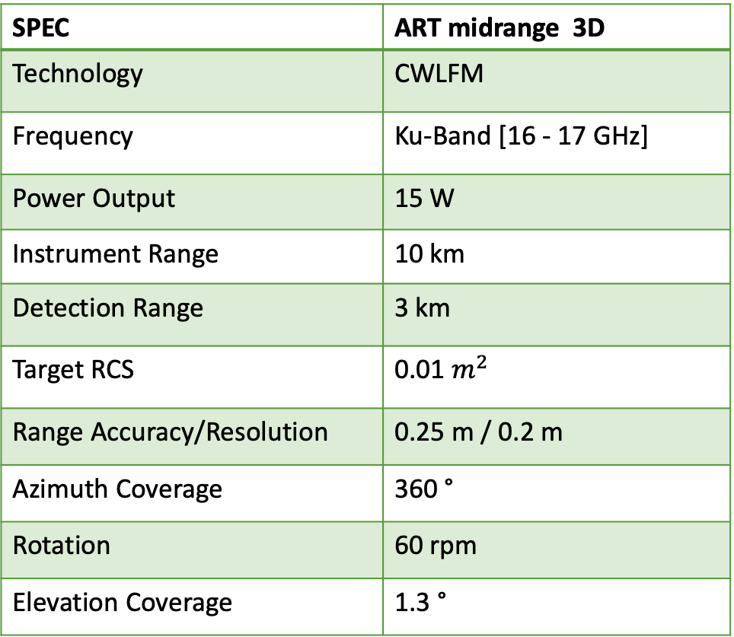
SPEC | ART midrange 3D
Technology | CWLFM
Frequency | Ku-Band [16 - 17 GHz]
Power Output | 15 W
Instrument Range | 10 km
Detection Range | 3 km
Target RCS | 0.01 $m^{2}$
Range Accuracy/Resolution | 0.25 m / 0.2 m
Azimuth Coverage | 360 °
Rotation | 60 rpm
Elevation Coverage | 1.3 °

Slide 25
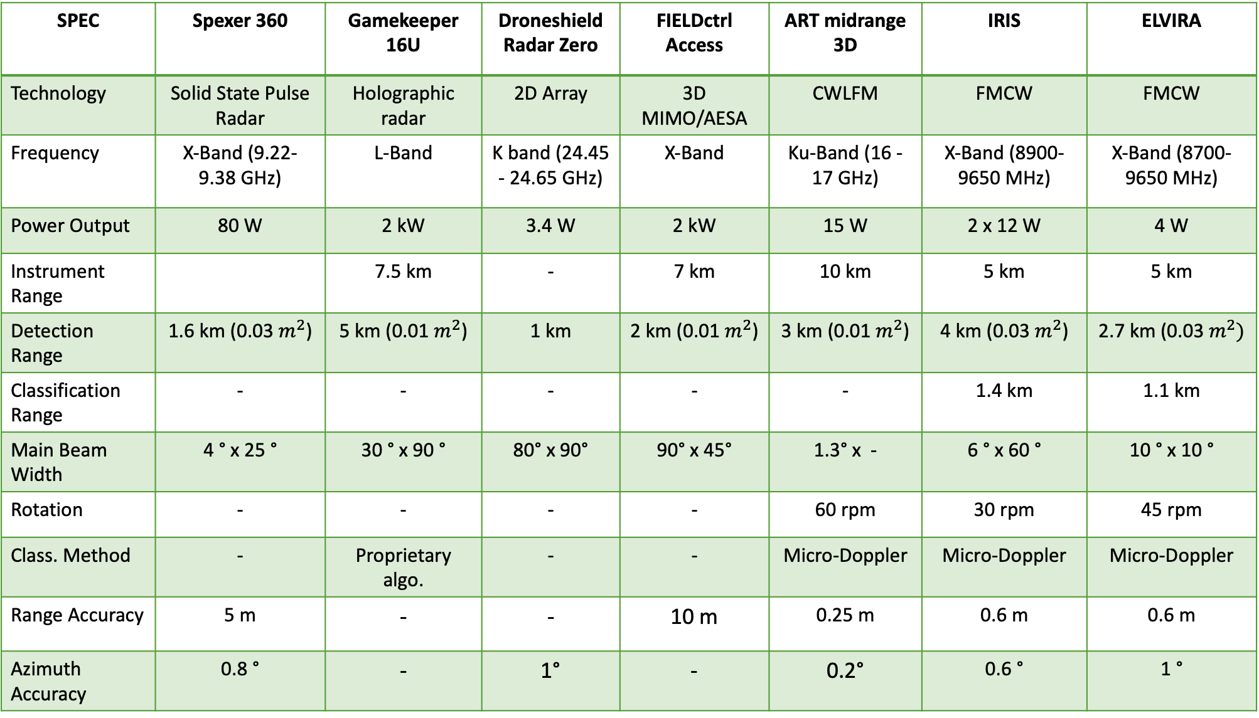
SPEC | Spexer 360 | Gamekeeper 16U | Droneshield Radar Zero | FIELDctrl Access | ART midrange 3D | IRIS | ELVIRA
Technology | Solid State Pulse Radar | Holographic radar | 2D Array | 3D MIMO/AESA | CWLFM | FMCW | FMCW
Frequency | X-Band (9.22-9.38 GHz) | L-Band | K band (24.45 - 24.65 GHz) | X-Band | Ku-Band (16 - 17 GHz) | X-Band (8900-9650 MHz) | X-Band (8700-9650 MHz)
Power Output | 80 W | 2 kW | 3.4 W | 2 kW | 15 W | 2 x 12 W | 4 W
Instrument Range |  | 7.5 km | - | 7 km | 10 km | 5 km | 5 km
Detection Range | 1.6 km (0.03 $m^{2}$) | 5 km (0.01 $m^{2}$) | 1 km | 2 km (0.01 $m^{2}$) | 3 km (0.01 $m^{2}$) | 4 km (0.03 $m^{2}$) | 2.7 km (0.03 $m^{2})$
Classification Range | - | - | - | - | - | 1.4 km | 1.1 km
Main Beam Width | 4 ° x 25 ° | 30 ° x 90 ° | 80° x 90° | 90° x 45° | 1.3° x - | 6 ° x 60 ° | 10 ° x 10 °
Rotation | - | - | - | - | 60 rpm | 30 rpm | 45 rpm
Class. Method | - | Proprietary algo. | - | - | Micro-Doppler | Micro-Doppler | Micro-Doppler
Range Accuracy | 5 m | - | - | 10 m | 0.25 m | 0.6 m | 0.6 m
Azimuth Accuracy | 0.8 ° | - | 1° | - | 0.2° | 0.6 ° | 1 °

Slide 26
Type of drone | Velocity of body | Blade tip velocity
Quadcopter drone | 70 km/h | 226 km/h
Helicopter drone | 70 km/h | 345 km/h

